Slide 1
Support Vector Machine
Abhijit Ramesh Patil

Slide 2
What is SVM ?
Support Vector Machine (SVM) is the one of the most popular Supervised Machine Learning algorithms, which is used for classification and regression problems.
Mostly it is used for classification problem in ML.
SVM helps to find best decision boundary called hyperplane that classify the data points.
SVM chooses vectors that help in creating the decision boundary. These vectors are called as support vectors and hence algorithm termed as Support Vector Machine.

Slide 3
What are different types of SVM ?
Types of SVM :
1. Linear Support Vector Machine (LSVM):
LSVM is used for linearly separable data that is if data set can be classified into 2 classes by using single straight line then such data is termed as Linearly Separable data.
2. Non Linear Support Vector Machine (NLSVM):
NLSVM is used for Non Linearly separated data that means If data set can not be classified by using straight line, then such data is termed as non linear data and classifier used is called as Non Linear SVM classifier.

Slide 4
Define Support vector, Margin, Hyperplane.
Support vectors:
Support vectors are the data points or vectors that are closest to the hyperplane.
SVM algorithm finds the closest point of lines from both the classes. These points are called as support vectors.
Margin:
The distance between support vector and hyperplane is called as margin and the goal of SVM is to maximise the margin.

Slide 5
Hyperplane:
The SVM algorithm helps to find the best line or decision boundary, this best boundary or region is called as Hyperplane.
Decision boundary helps to classify the datapoints.
WE always create a hyperplane that has maximum margin which means the maximum distance between the datapoints.
The hyperplane with maximum margin is called as Optimal Hyperplane.

Slide 6
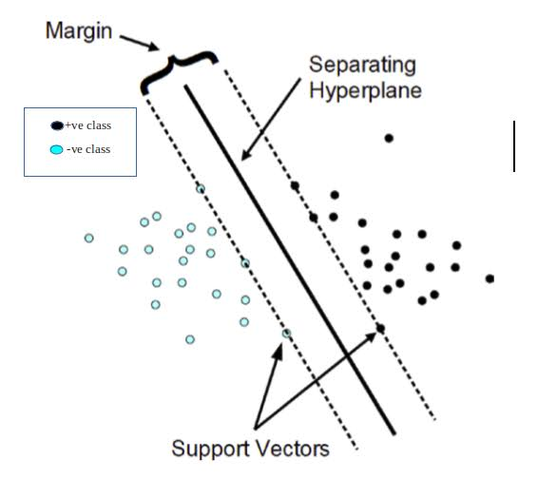

Slide 7
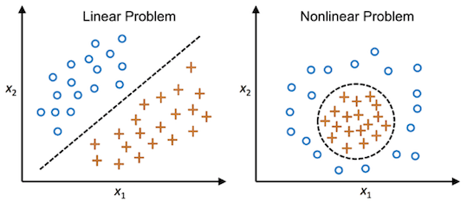
What is the difference between Linearly separable dataset & Non linearly separable dataset ?

Slide 8
How Kernel tricks is useful in NLSVM ?
A Kernel function transforms a low dimensional input data space into higher dimensional space.
Kernel function converts non linear separable problems to linear separable problems by adding more dimensions to it.
Kernel helps to build more accurate classifier.
It is useful in non linear separation problems
There are 4 popular Kernels
Linear Kernel, Polynomial Kernel, Radial Basis Function (also known as Gaussian function) and Sigmoid kernel.

Slide 9
What are Pros and Cons of SVM?
Pros of SVM :
It is highly accurate
It is able to handle many features
Works well even if data is not linearly separable
Solves complex problems with convenient kernel solution function
SVM is more effective in high dimensional spaces
Cons of SVM :
Its speed is low
It require more time to process
High memory usage
SVM is not suitable for large data set
SVM does not perform very well when data set has more noise that is target classes are overlapping

Slide 10
What are application of SVM ?
Face detection
Text and Hypertext categorization
Classification of images
Bioinformatics
Handwriting recognition

